Slide 1
Introduction to Management and Organizations
Chapter 1

Slide 2
L E A R N I N G O U T L I N E Follow this Learning Outline as you read and study this chapter.
Who Are Managers?
Explain how managers differ from non-managerial employees.
Describe how to classify managers in organizations.
What Is Management?
Define management.
Explain why efficiency and effectiveness are important to management.

Slide 3
L E A R N I N G O U T L I N E (cont’d) Follow this Learning Outline as you read and study this chapter.
What Do Managers Do?
Describe the four functions of management.
Explain Mintzberg’s managerial roles.
Describe Katz’s three essential managerial skills and how the importance of these skills changes depending on managerial level.
Discuss the changes that are impacting managers’ jobs.
Explain why customer service and innovation are important to the manager’s job.

Slide 4
L E A R N I N G O U T L I N E (cont’d) Follow this Learning Outline as you read and study this chapter.
What Is An Organization?
Describe the characteristics of an organization.
Explain how the concept of an organization is changing.
Why Study Management?
Explain the universality of management concept.
Discuss why an understanding of management is important.
Describe the rewards and challenges of being a manager.

Slide 5
Who Are Managers?
Manager
Someone who coordinates and oversees the work of other people so that organizational goals can be accomplished.

Slide 6
Classifying Managers
First-line Managers
Individuals who manage the work of non-managerial employees.
Middle Managers
Individuals who manage the work of first-line managers.
Top Managers
Individuals who are responsible for making organization-wide decisions and establishing plans and goals that affect the entire organization.

Slide 7
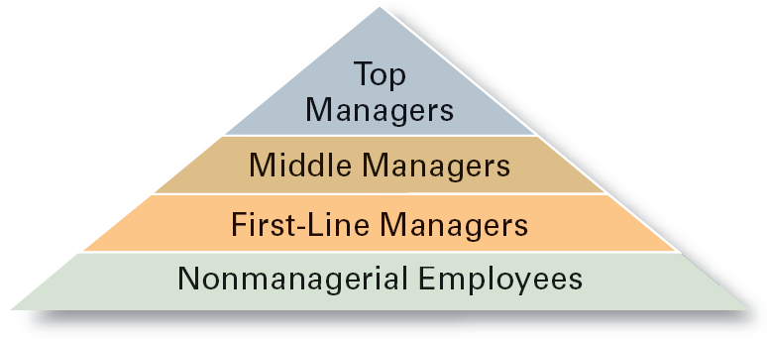
Exhibit 1–1 Managerial Levels

Slide 8
What Is Management?
Managerial Concerns
Efficiency
“Doing things right”
Getting the most output for the least inputs
Effectiveness
“Doing the right things”
Attaining organizational goals

Slide 9
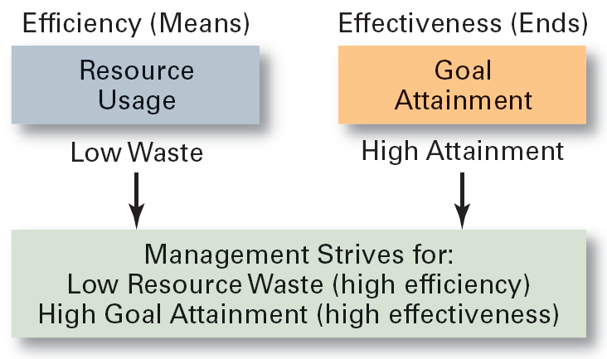
Exhibit 1–4 Effectiveness and Efficiency in Management

Slide 10
What Do Managers Do?
Functional Approach
Planning
Defining goals, establishing strategies to achieve goals, developing plans to integrate and coordinate activities.
Organizing
Arranging and structuring work to accomplish organizational goals.
Leading
Working with and through people to accomplish goals.
Controlling
Monitoring, comparing, and correcting work.

Slide 11
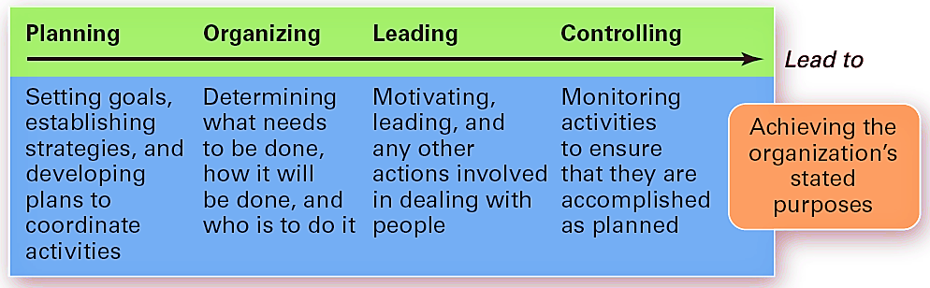
Exhibit 1–5 Management Functions

Slide 12
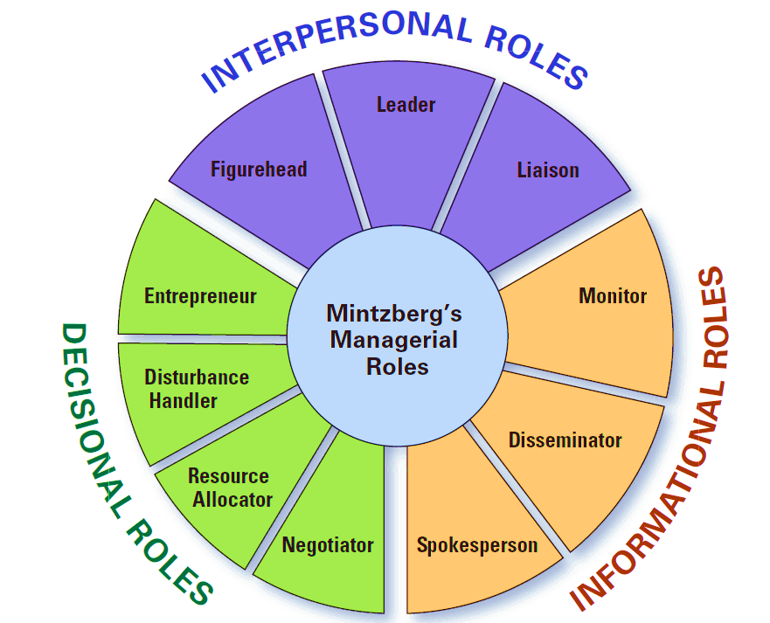
What Do Managers Do? (cont’d)
Management Roles Approach (Mintzberg)
Interpersonal roles
Figurehead, leader, liaison
Informational roles
Monitor, disseminator, spokesperson
Decisional roles
Disturbance handler, resource allocator, negotiator

Slide 13
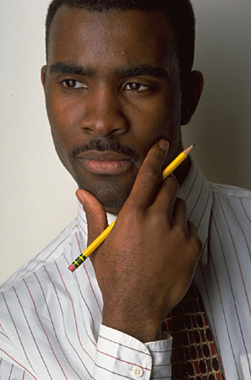
What Managers Actually Do (Mintzberg)
Interaction
with others
with the organization
with the external context of the organization
Reflection
thoughtful thinking
Action
practical doing

Slide 14
What Do Managers Do? (cont’d)
Skills Approach
Technical skills
Knowledge and proficiency in a specific field
Human skills
The ability to work well with other people
Conceptual skills
The ability to think and conceptualize about abstract and complex situations concerning the organization

Slide 15
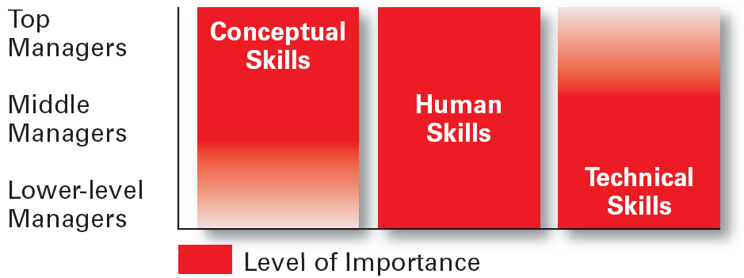
Exhibit 1–5 Skills Needed at Different Management Levels

Slide 16
Exhibit 1–6 Conceptual Skills
Using information to solve business problems
Identifying of opportunities for innovation
Recognizing problem areas and implementing solutions
Selecting critical information from masses of data
Understanding of business uses of technology
Understanding of organization’s business model
Source: Based on American Management Association Survey of Managerial Skills and Competencies, March/April 2000, found on AMA Web site (www.ama.org), October 30, 2002.

Slide 17
Exhibit 1–6 Communication Skills
Ability to transform ideas into words and actions
Credibility among colleagues, peers, and subordinates
Listening and asking questions
Presentation skills; spoken format
Presentation skills; written and/or graphic formats
Source: Based on American Management Association Survey of Managerial Skills and Competencies, March/April 2000, found on AMA Web site (www.ama.org), October 30, 2002.

Slide 18
Exhibit 1–6 Effectiveness Skills
Contributing to corporate mission/departmental objectives
Customer focus
Multitasking: working at multiple tasks in parallel
Negotiating skills
Project management
Reviewing operations and implementing improvements
Source: Based on American Management Association Survey of Managerial Skills and Competencies, March/April 2000, found on AMA Web site (www.ama.org), October 30, 2002.

Slide 19
Exhibit 1–6 Effectiveness Skills (cont’d)
Setting and maintaining performance standards internally and externally
Setting priorities for attention and activity
Time management
Source: Based on American Management Association Survey of Managerial Skills and Competencies, March/April 2000, found on AMA Web site (www.ama.org), October 30, 2002.

Slide 20
Exhibit 1–6 Interpersonal Skills (cont’d)
Coaching and mentoring skills
Diversity skills: working with diverse people and cultures
Networking within the organization
Networking outside the organization
Working in teams; cooperation and commitment
Source: Based on American Management Association Survey of Managerial Skills and Competencies, March/April 2000, found on AMA Web site (www.ama.org), October 30, 2002.

Slide 21
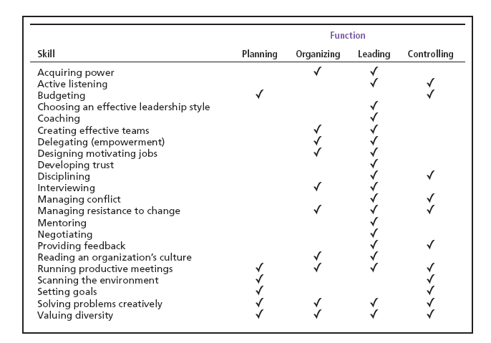
Exhibit 1–7 Management Skills and Management Function Matrix

Slide 22
How The Manager’s Job Is Changing
The Increasing Importance of Customers
Customers: the reason that organizations exist
Managing customer relationships is the responsibility of all managers and employees.
Consistent high quality customer service is essential for survival.
Innovation
Doing things differently, exploring new territory, and taking risks
Managers should encourage employees to be aware of and act on opportunities for innovation.

Slide 23
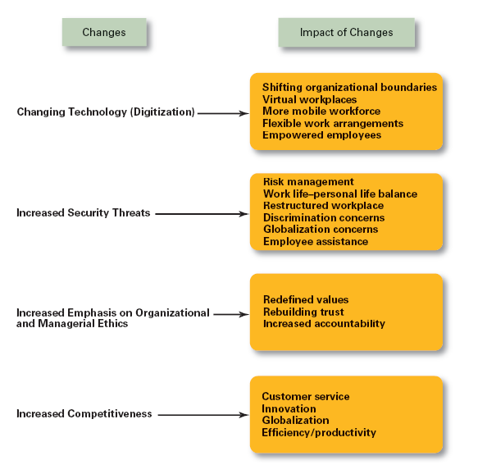
Exhibit 1–8 Changes Impacting the Manager’s Job

Slide 24
What Is An Organization?
An Organization Defined
A deliberate arrangement of people to accomplish some specific purpose (that individuals independently could not accomplish alone).
Common Characteristics of Organizations
Have a distinct purpose (goal)
Composed of people
Have a deliberate structure

Slide 25
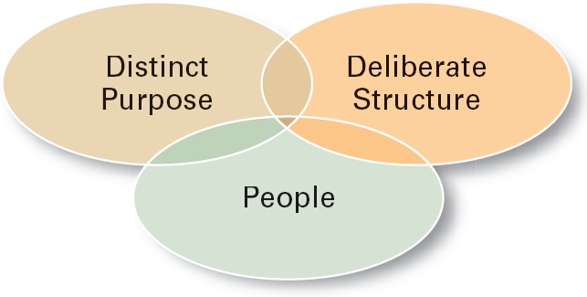
Exhibit 1–9 Characteristics of Organizations

Slide 26
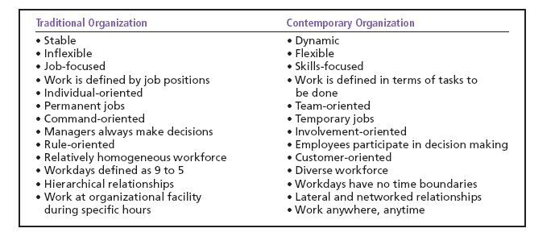
Exhibit 1–10 The Changing Organization

Slide 27
Why Study Management?
The Value of Studying Management
The universality of management
Good management is needed in all organizations.
The reality of work
Employees either manage or are managed.
Rewards and challenges of being a manager
Management offers challenging, exciting and creative opportunities for meaningful and fulfilling work.
Successful managers receive significant monetary rewards for their efforts.

Slide 28
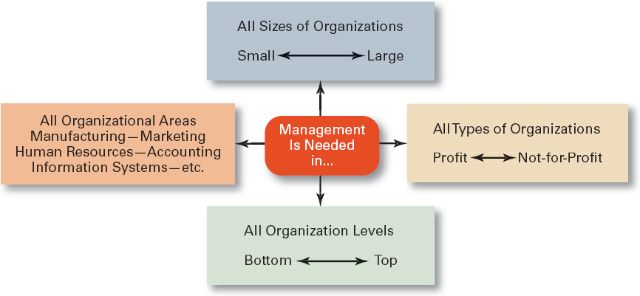
Exhibit 1–11 Universal Need for Management

Slide 29
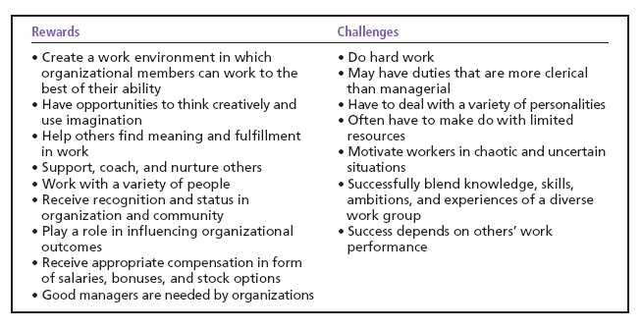
Exhibit 1–12 Rewards and Challenges of Being A Manager

Slide 30
Terms to Know
manager
first-line managers
middle managers
top managers
management
efficiency
effectiveness
planning
organizing
leading
controlling
management roles
interpersonal roles
informational roles
decisional roles
technical skills
human skills
conceptual skills
organization
universality of management

